Slide 1

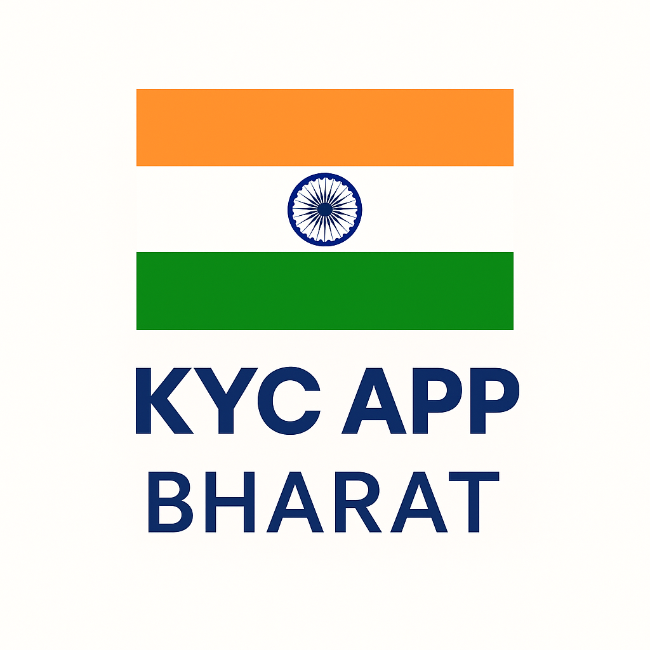
LightWeight KYC App for Bharat
Presenter name : - Medhaj Gajanan Chaudhari
date:- 10 August 2025
Company Name :- Hyperverge

Slide 2
Problem Statement
1
4
Accessibility Gap
Time-Consuming & Manual Processes
2
5
Rural Connectivity Issues
Trust & Transparency Concerns
3
6
Fragmented User Experience
Reduced adoption digital KYC systems.

Slide 3
Features Overview
DigiLocker API – Secure, direct document fetch from govt database.
OCR & Auto Classification – AI reads & detects doc type instantly.
On-device Face Match – Works offline, ensures privacy.
Offline Mode – Retry/resume without restarting KYC.
Voice Assistance – Multilingual guidance for low-literacy users.
Explain My KYC (LLM) – Simple, transparent explanations to build trust.

Slide 4
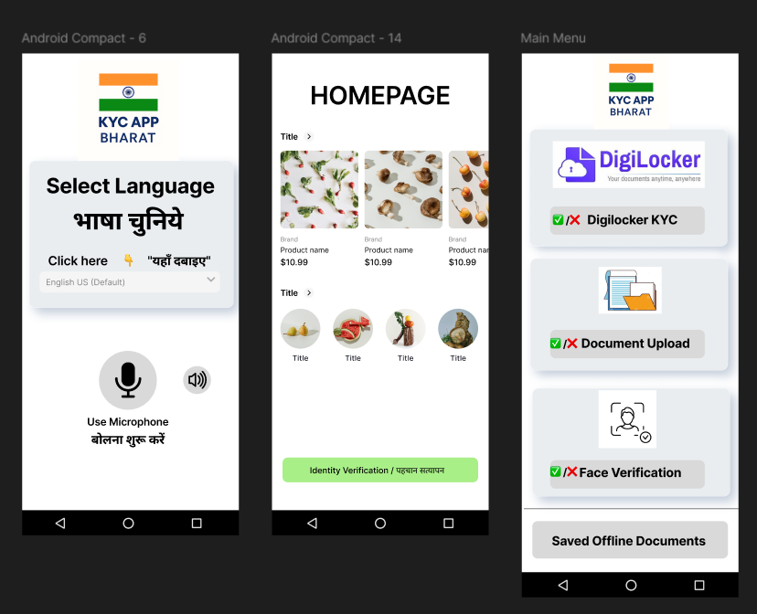
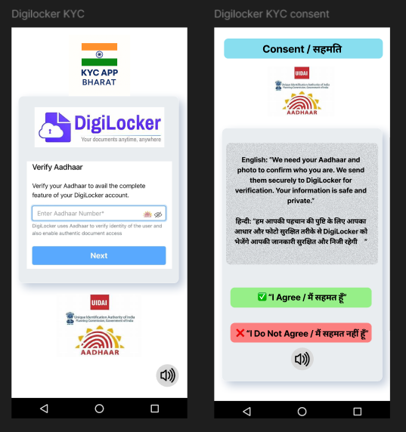
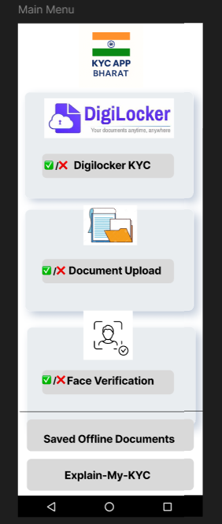
App Overview .

Slide 5
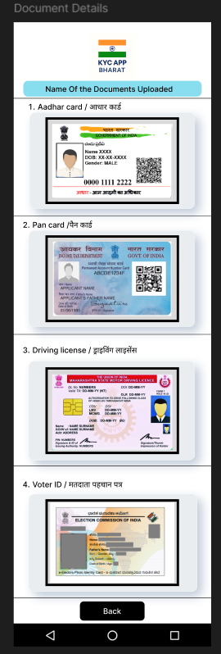
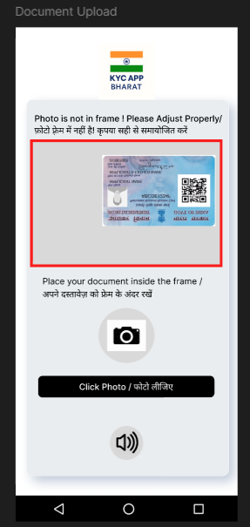
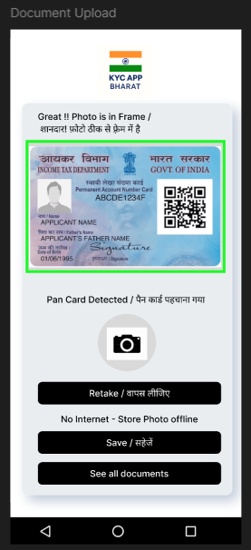
App Overview .

Slide 6
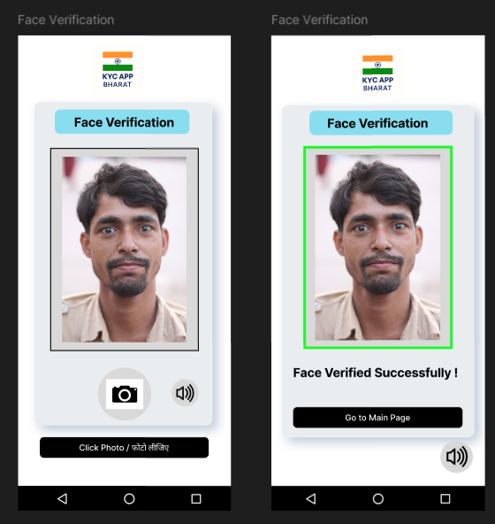
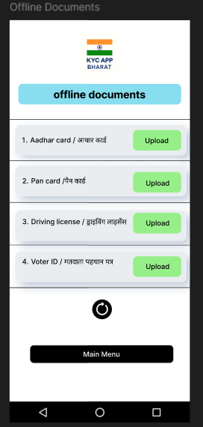
App Overview .

Slide 7
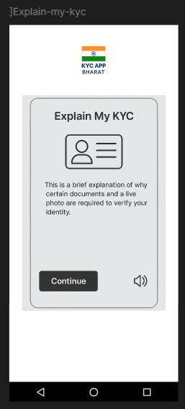
App Overview .

Slide 8
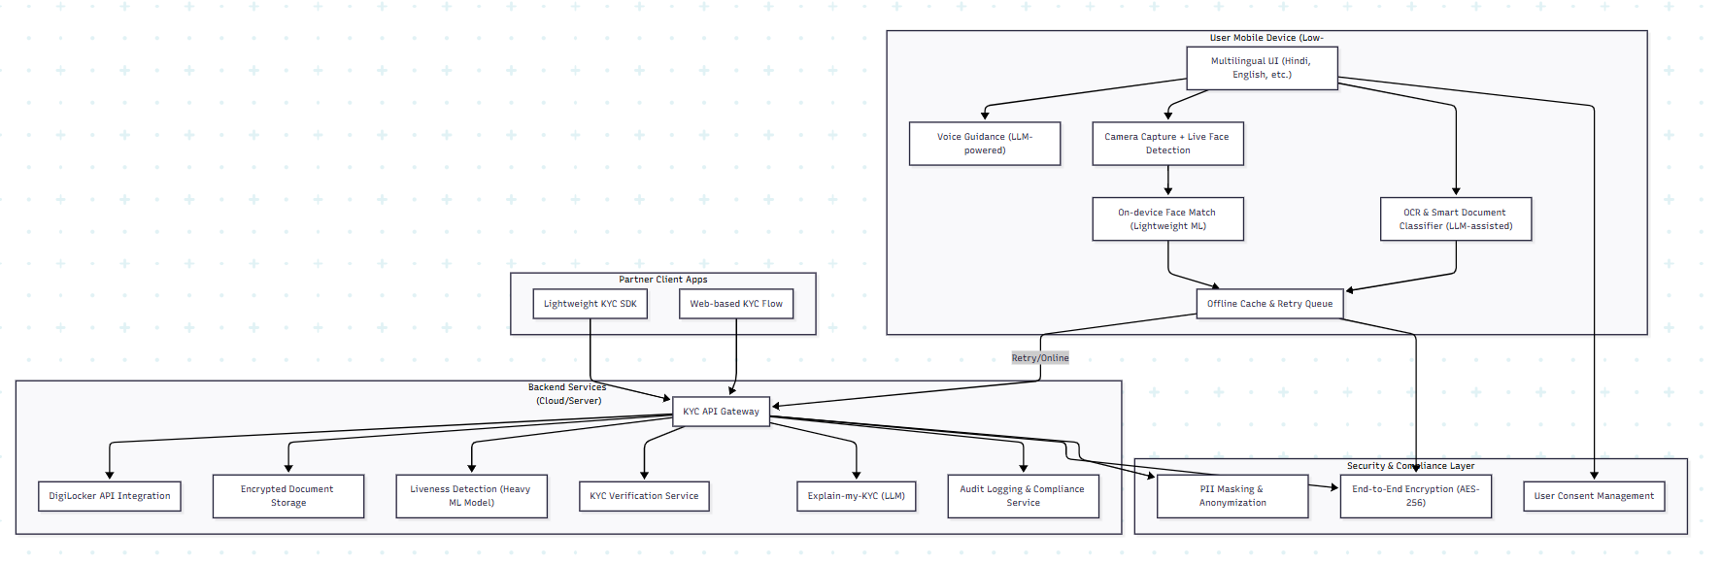
Architecture Diagram

Slide 9
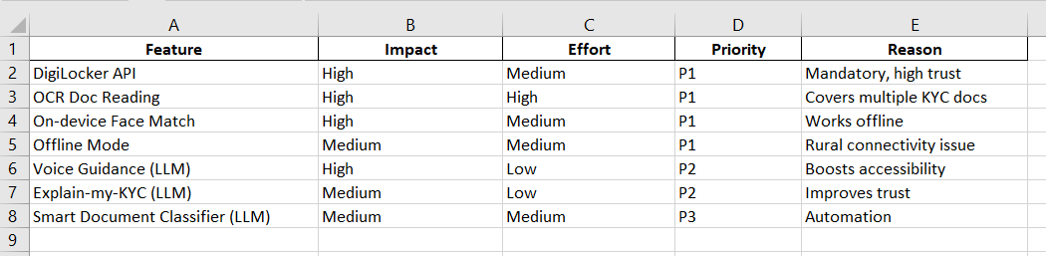
Prioritization Matrix

Slide 10



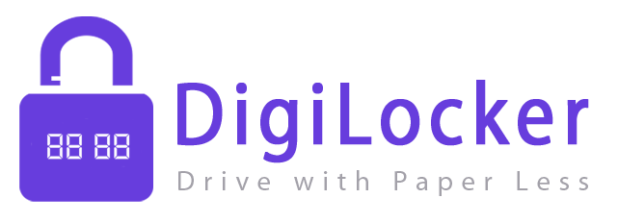


Tech Stack
Backend
Node.js – API handling, real-time processing.
Python – OCR, face recognition, LLM-powered features.
Frontend
React Native – Lightweight, cross-platform mobile app.
APIs & Integrations
DigiLocker API – Secure document fetch.
Face Recognition API – Liveness + facematch checks.
OCR Service – Document text extraction.
Deployment & Security
AWS / Azure Cloud – Scalable & reliable hosting.
Data Encryption – AES-256 at rest, TLS in transit.
On-device Processing – Privacy & offline support.

Slide 11
Benefits & Impact
1. Improved Trust & Speed
LLM-powered explanations make the process transparent.
Automated checks reduce manual verification time.
2. Rural & Multilingual Reach
Supports Hindi, English, and other regional languages.
Works offline in low-connectivity areas.
3. Accessibility & Inclusivity
Voice guidance for users with low digital literacy.
Simple, icon-driven UI.
4. Compliance Advantages
Meets KYC and data security regulations.
Digital audit trails for verification.

Slide 12
Thank You…

